Slide 1

DEDEKIND
The Programming Language for Science
Physical Units • Differentiable Solvers • GPU Native
Mario Michael Heinrich
Founder | github.com/Engineer1080 | v1.3.1

Slide 2
Nature's Laws Native in Code
Replacing fragile scripts with a language that understands the fundamental grammar of physics and mathematics.

Slide 3


SCIENCE'S SILENT CRISIS
Dimensional Errors
~30% of scientific software bugs stem from wrong units. Unit errors caused the $125M Mars Climate Orbiter crash.
Boilerplate Friction
Researchers waste thousands of hours rewriting ODE solvers and manual uncertainty propagation in Python/MATLAB.
Irreproducibility
Manual tracking and disconnected publication tools make scientific results impossible to verify or scale.

Slide 4






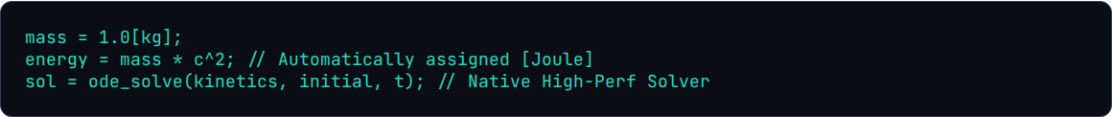
THE DEDEKIND SOLUTION
Type-Safe Units
Differentiable
LaTeX First
Enforced at compile-time. Adding 1[m] to 1[s] triggers an error instantly, not at runtime.
Native grad() support for ODE/PDE solvers, enabling effortless Physics-Informed ML and optimization.
Built-in publication tools. Export verified code definitions directly to peer-reviewed LaTeX documents.

Slide 5
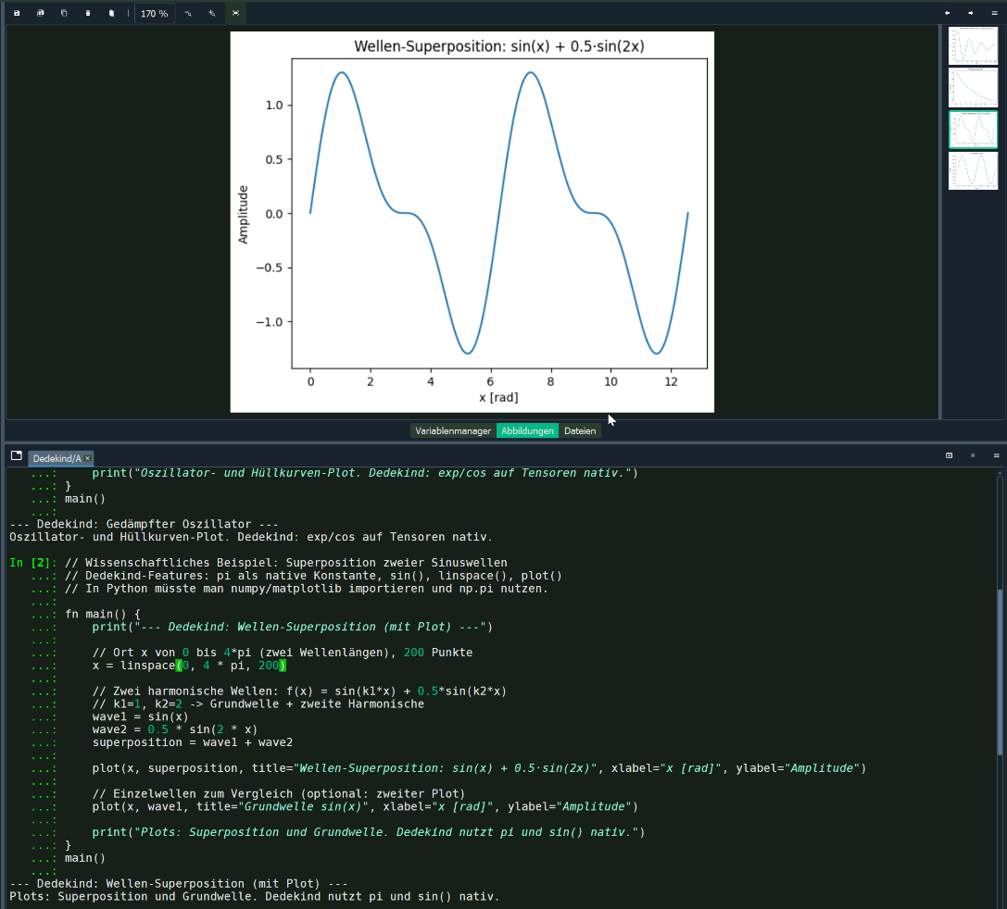
DEDEKIND STUDIO
The Next-Gen Scientific IDE
A high-performance fork of Spyder designed for discovery. Unified environment for coding, plotting, and real-time physical verification.
Live Unit Verification
Interactive Physical Plotting
LaTeX Definition Preview
Scientific Notation in the Terminal

Slide 6
UNCOMPROMISING TECH STACK
Component | Technology | Value Proposition
Compiler | MLIR / LLVM Backend | Progressive lowering for heterogeneous hardware (CPU/GPU/TPU).
GPU Acceleration | Triton Kernels (OpenAI) | Hardware-agnostic, block-level GPU programming native to the IR.
Parallelism | Work-Stealing Scheduler | Provably optimal dynamic load balancing for nested simulations.
Safety | Affine Type System | Memory safety and data-race prevention without garbage collection.

Slide 7
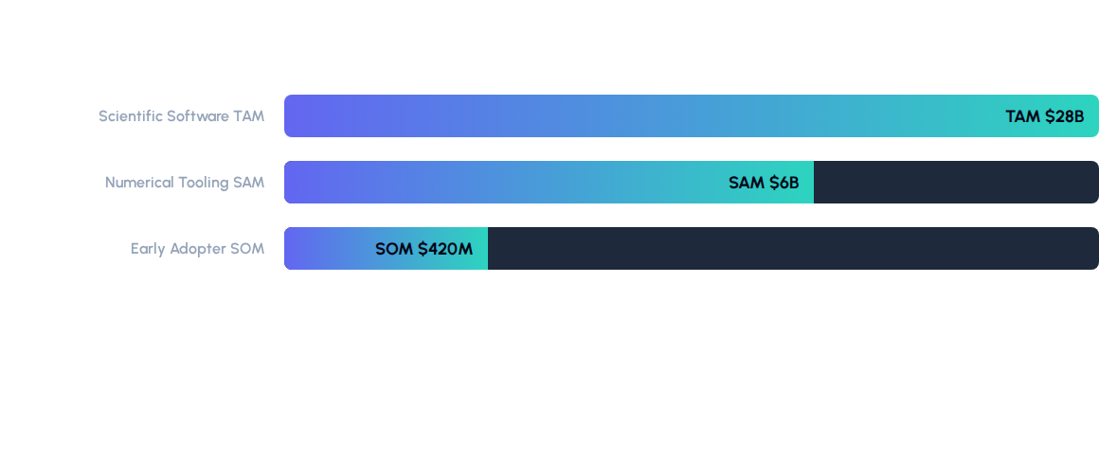
GLOBAL MARKET OPPORTUNITY
"Researchers globally waste $2.1B annually on errors that Dedekind prevents by design."

Slide 8



SCALABLE REVENUE STREAMS
Open Source Core
SaaS & Pro
Enterprise Licensing
MIT-licensed compiler and basic IDE to drive rapid academic adoption and ecosystem network effects.
Team collaboration, cloud solvers, and premium IDE features. Recurring revenue from labs and R&D teams.
Custom SLA, support, and embedded engine licensing for Pharma, Defense, and Engineering firms.
€49 - €299 / mo

Slide 9
2026 STRATEGY & ROADMAP
Jan 2026
Q3 2026
Q4 2026
2027
Launch
v1.0 Release
Ecosystem
Scale
Core Unit Checker and MLIR Prototype.
Dedekind Studio stable for early adopters.
100+ native solvers and Jupyter integration.
Enterprise cloud-native solver launch.

Slide 10
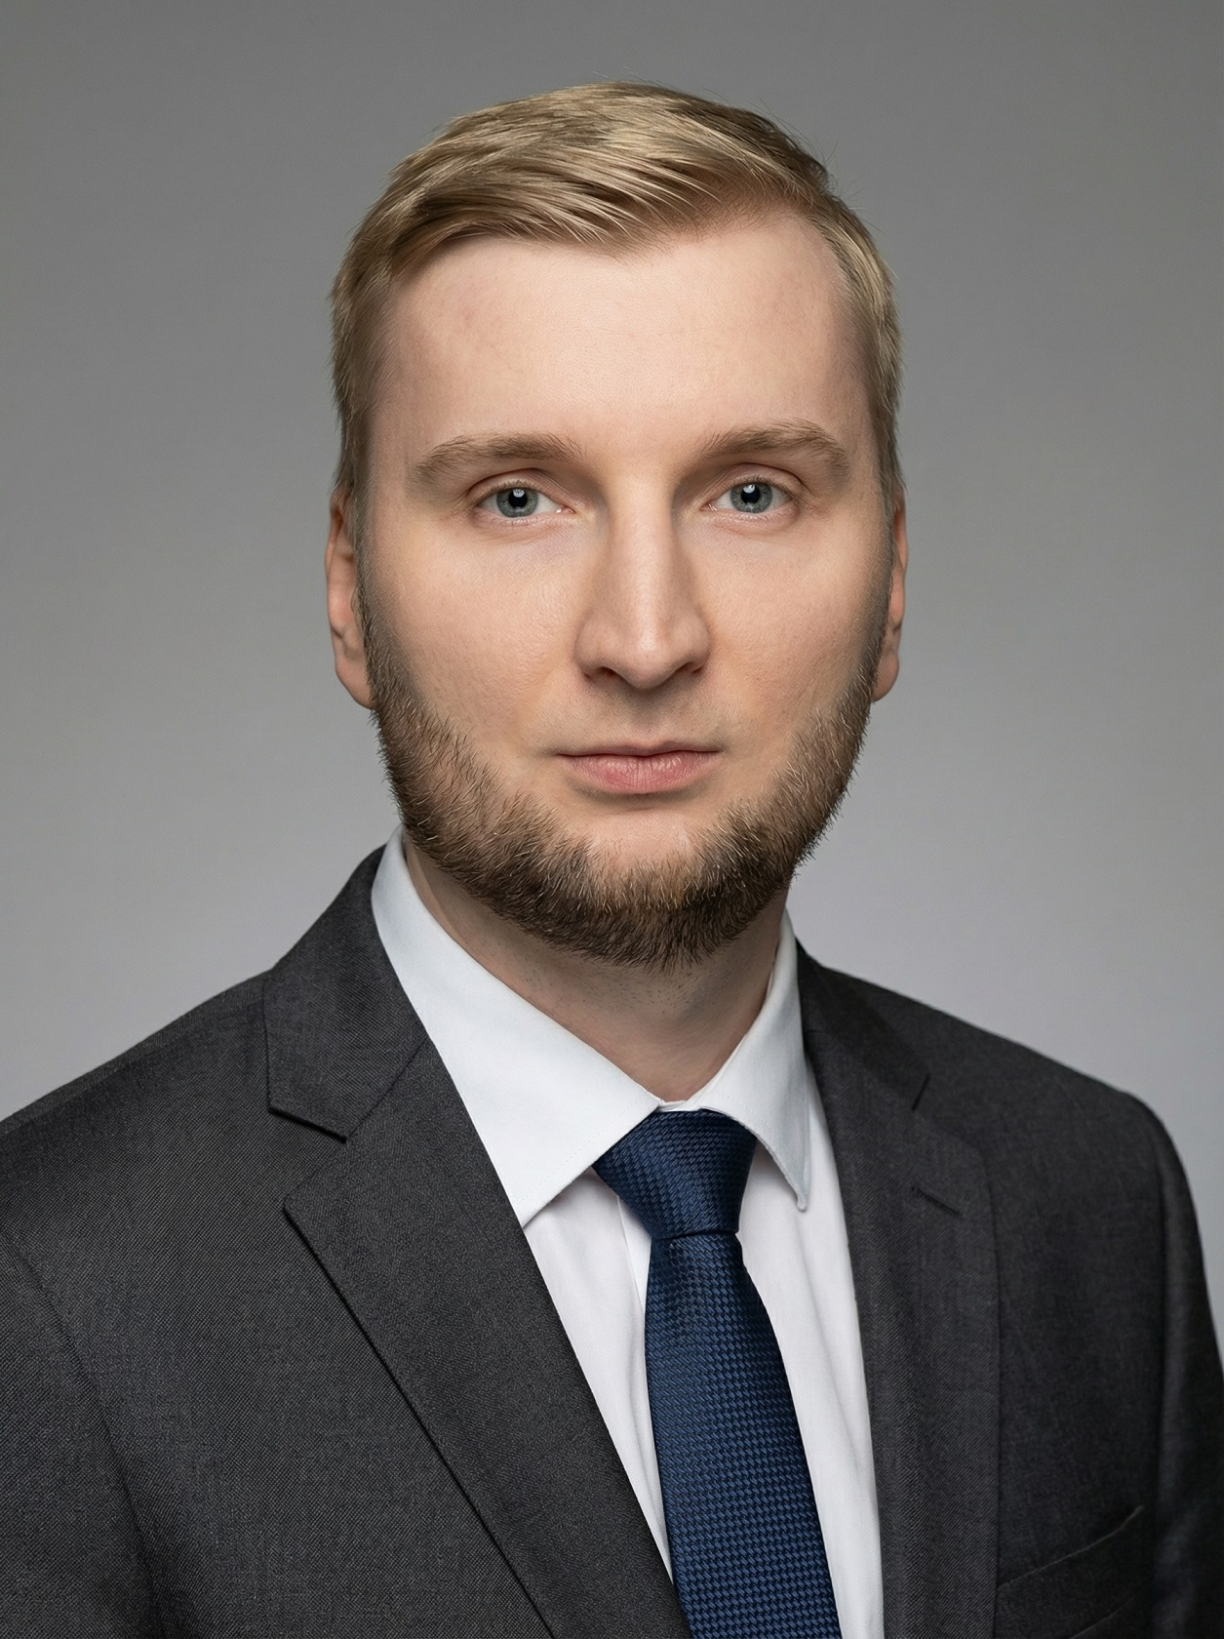
FOUNDER & LEAD ARCHITECT
Mario Michael Heinrich
Serial AI Builder & Language Creator
4x Hackathon Winner: Meta, XIBIX & the Max-Planck-Challenge
(Anthropic x TUM.ai Hackathon).
Inventor: High-performance Prime Number Generation Algorithm.
Founder: Creator of easy-job.ai and easy-quiz.ai.

Slide 11
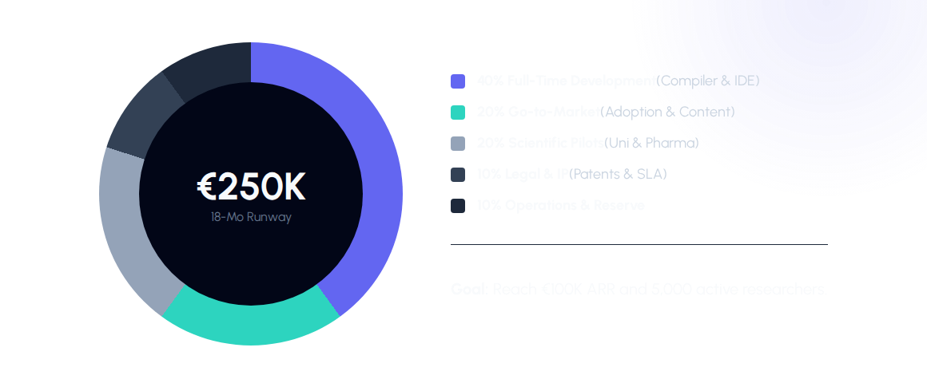
SEED ASK: €250,000

Slide 12
Questions?
Let's build the future of scientific computing together.
Resources
Contact
github.com/Engineer1080
Deggendorf, Germany
Dedekind-Language.com
MIT Licensed Core

